Slide 1

CEE 465/CEWA 565: Data Analysis: Week 2
Jessica Lundquist, Civil and Environmental Engineering, UW, Fall 2019

Slide 2
Announcements
Homework questions: Please post. We’ll post replies so that everyone can see them.
I’m not trying to confuse you (it just happens sometimes) – we will try to clarify on the announcement or discussion posts. If the answers still don’t make sense, just ask again.
We will respond within 24 hours (but you can’t expect a faster response).

Slide 3
Announcements
Steven will hold office hours Wednesdays 1:00-2:20 in MEB 250. If you can’t be here in person, Steven will have Zoom available: join the virtual office hours on Wednesdays 1:00-2:20 pm with this link: https://washington.zoom.us/j/494566322?pwd=M3IyVlNQdG1UWm0zTG1taTN0Nmlxdz09
See Steven’s post for link you can click on
If you have ideas to make lecture recordings more user-friendly, let me know.

Slide 4
Announcements
Google is your friend. (That’s how I find the answer to many of your questions.)
Homework 2 is posted. Lab 2 (Tues) will be related to HW 1 and 2, and Lab 3 (Thurs) will be similar to Homework 2. [It’s fine if you are still working on Lab 1 and Homework 1 today.]
Things will vary more next week, but because hypothesis testing is hard, we’re giving very concrete examples this week.

Slide 5
Where are we in the course
Last week, we discussed how we make measurements and how we make sense of the sample of measurements we have to try to make educated guesses about all of reality that we didn’t manage to measure
We worked on plotting and visualizing data

Slide 6
Basic Graphical Data Analysis
Always plot your data before doing anything else
Always label your plots clearly
Look at the pictures in H&H Ch 2

Slide 7
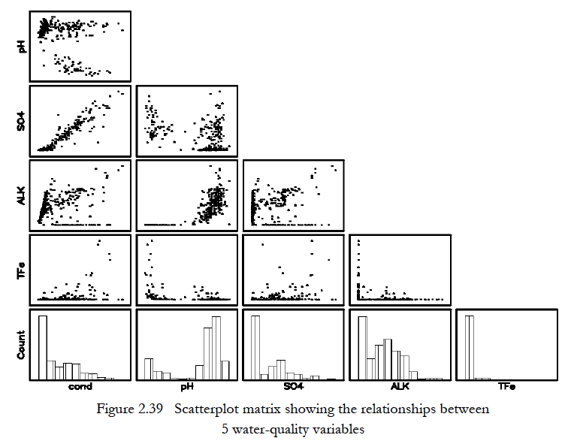
Basic scatterplots & histograms

Slide 8
Why are you plotting?
Ethics in graphical analysis

Slide 9
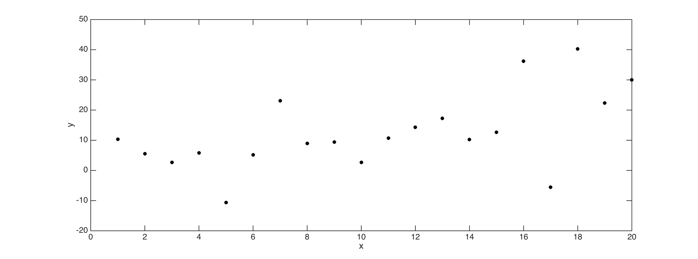
Axis Limits and Perspective: Is there a trend in this data?

Slide 10
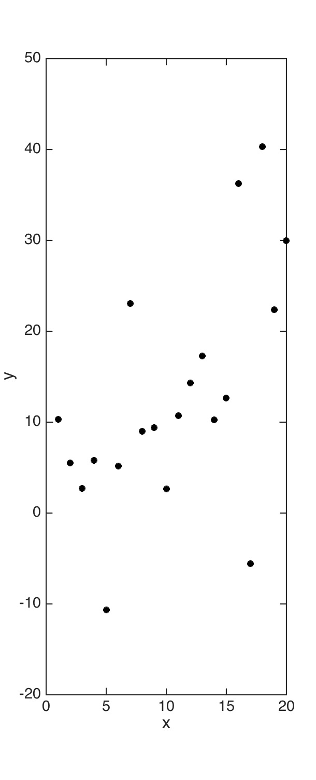
Axis Limits and Perspective: Is there a trend in this data?

Slide 11
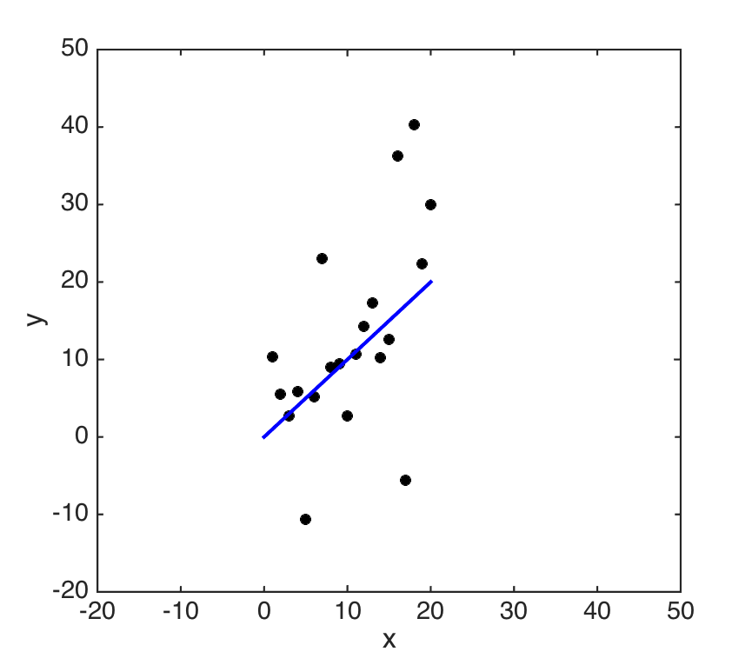
Axis limits and perspective: Is there a trend in this data?

Slide 12
Secrets of my dataset
I made up 20 numbers
X = 1:20;
Y= x+10.*randn(1,20);
This is a line with a lot of normally distributed noise.
There is a trend in this data, but it is hard to detect.

Slide 13
Basic Reporting of Numbers
Significant figures
Units
Think about our pole in the snow (thumbs up or thumbs down).
Should I tell you that the snow depth 20.2315 cm?
Should I tell you that the snow depth is 2023 mm?

Slide 14
Basic Reporting of Numbers
Significant figures
Think about our pole in the snow.
For each number you report, consider the certainty with which you know that number, and don’t include any more precision than that.
Note: Rounding errors – the computer needs to include many numbers past the decimal point to avoid rounding errors (so don’t truncate number in your code), but also, don’t include every number past the decimal point that the computer saved in your report.

Slide 15
Population Statistics:
The underlying (“true”) statistical characteristics of a probability distribution
OR
(somewhat imprecisely)
The statistical characteristics extracted from a large sample from an assumed stationary probability distribution (e.g. statistics from a sample of 1,000 randomly sampled values).
Note: often inferred, but rarely known in practice.
(In many cases we don’t even know if the samples we have came from the same population or not.)
Sample statistics:
Statistics from a relatively small sample extracted from a known or unknown probability distribution.
This is what we usually have available to us in practice.

Slide 16
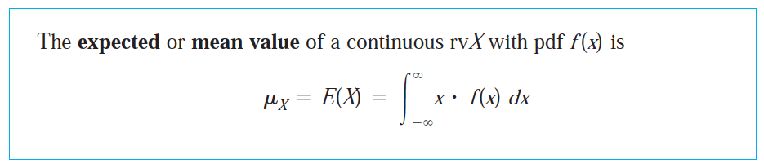
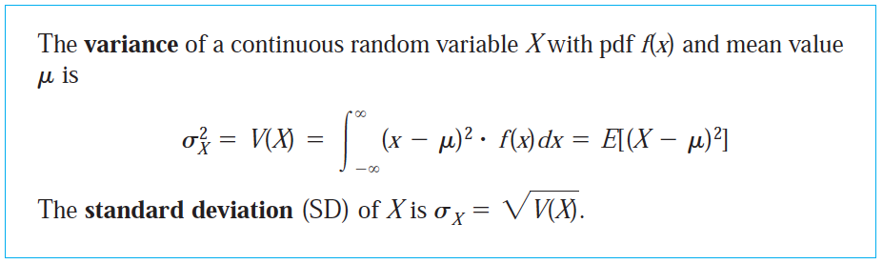
Theory: Expected Values, Moments, Mean, Variance, Standard Deviation
First moment
Second moment
From Devore, also see: https://en.wikipedia.org/wiki/Moment_(mathematics)

Slide 17
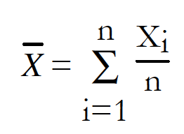
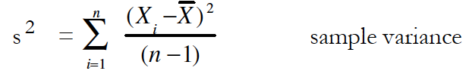
Sample mean and sample variance
Sample mean
See Ch 1 of Helsel and Hirsch.

Slide 18
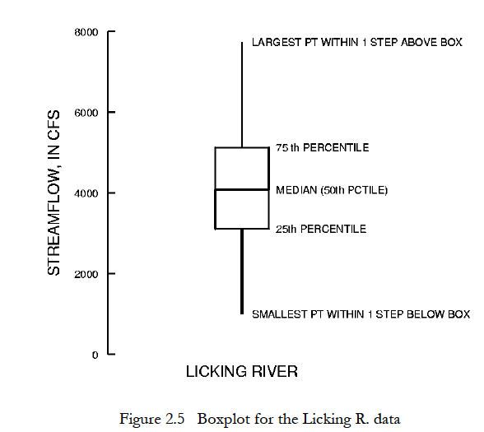
Box & whisker plots

Slide 19
Probability Distributions
One way to assess data is to assume it came from a certain distribution
PDF’s, CDF’s, Quantile Plots for different distributions
Using Random Number Generators to better understand statistics (This is related to HW 1, Problem 2)

Slide 20
Uniform Distribution on the interval [0,1]
PDF = Probability Density Function
F(x) = 1
CDF = Cumulative Distribution Function
F(x) = x
Probability of occurance (PDF)
Probability of value <= given value (CDF)
value

Slide 21
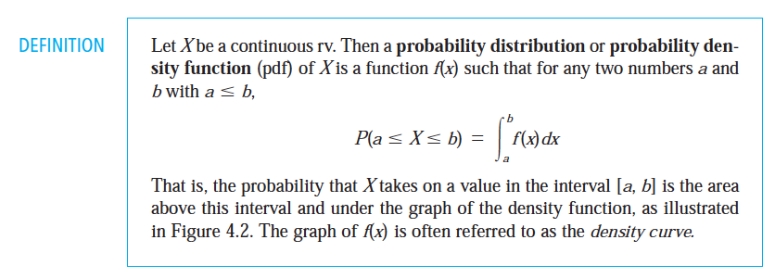
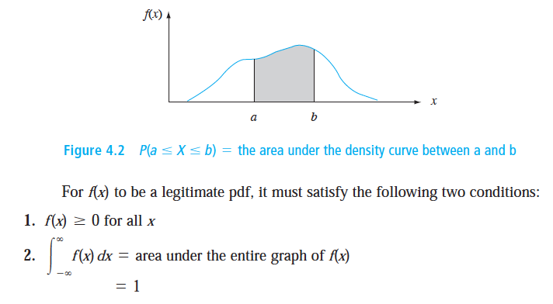
Theory: PDF
Imprecise: The probability, or likelihood, that a number will fall between any two values of a given distribution of numbers. Area under the total curve equals 1.
Note: Probability mass function (pmf) is used for discrete sets of numbers (e.g, binomial distribution).
Always p(x) >=0 and Sum over all possible x of p(x)=1.
Snapshots from Devore (p143 of 9th edition, p 139 of 5th edition)

Slide 22
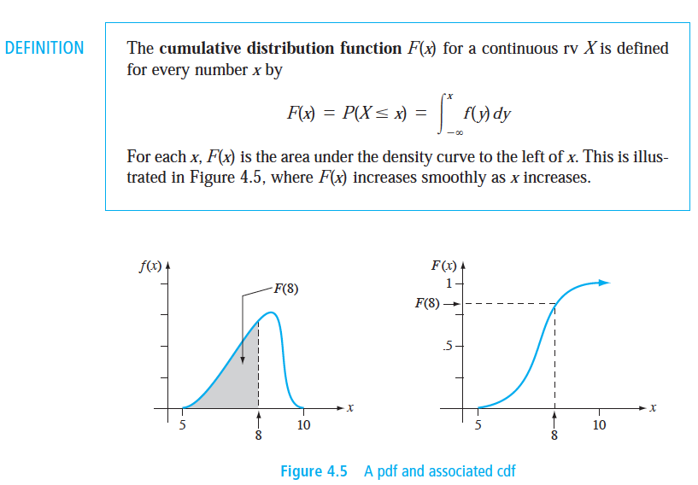
Theory: CDF
Imprecise: The probability, or likelihood, that a number will be equal to or less than a given number. Varies from 0 for lowest number to 1 for highest number.
Snapshot from Devore (p 148 of 9th edition)

Slide 23
Uniform Distribution on the interval [0,1]
PDF = Probability Density Function
F(x) = 1
CDF = Cumulative Distribution Function
F(x) = x
Probability of occurance (PDF)
Probability of value <= given value (CDF)
value

Slide 24
Population Statistics:
The underlying (“true”) statistical characteristics of a probability distribution
OR
(somewhat imprecisely)
The statistical characteristics extracted from a large sample from an assumed stationary probability distribution (e.g. statistics from a sample of 1,000 randomly sampled values).
Note: often inferred, but rarely known in practice.
(In many cases we don’t even know if the samples we have came from the same population or not.)
Sample statistics:
Statistics from a relatively small sample extracted from a known or unknown probability distribution.
This is what we usually have available to us in practice.

Slide 25
Theory: Expected Values, Moments, Mean, Variance, Standard Deviation
First moment
Second moment
From Devore, also see: https://en.wikipedia.org/wiki/Moment_(mathematics)

Slide 26
What is the Expected Value of the Uniform Distribution
on the interval [0,1] ?
PDF = Probability Density Function
F(x) = 1
CDF = Cumulative Distribution Function
F(x) = x
Probability of occurance (PDF)
Probability of value <= given value (CDF)
value

Slide 27
What is the Expected Value of the Uniform Distribution
on the interval [0,1] ?
PDF = Probability Density Function
F(x) = 1
CDF = Cumulative Distribution Function
F(x) = x
Probability of occurance (PDF)
Probability of value <= given value (CDF)
value

Slide 28
What is the Variance of the Uniform Distribution
on the interval [0,1] ?
PDF = Probability Density Function
F(x) = 1
CDF = Cumulative Distribution Function
F(x) = x
Probability of occurance (PDF)
Probability of value <= given value (CDF)
value

Slide 29
What is the Variance of the Uniform Distribution
on the interval [0,1] ?
PDF = Probability Density Function
F(x) = 1
CDF = Cumulative Distribution Function
F(x) = x
Probability of occurance (PDF)
Probability of value <= given value (CDF)
value

Slide 30
If the prior slide didn’t make sense, or you don’t like doing integrals,
you can find help on your homework for what the standard deviation is for a uniform distribution.
Check out Wikipedia (and scroll down to characterization in terms of mean and variance).
https://en.wikipedia.org/wiki/Uniform_distribution_(continuous)

Slide 31
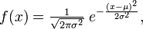
PDF = Probability Density Function , for a Normal Distribution
Highest likelihood of occurring
Diminishing likelihood of occurring
Area under the curve = 1.0
Standard Normal Distribution: Mean = 0, Std Deviation =1
Note: Most statistical tests we use are based on this “standard normal.”

Slide 32
CDF = Cumulative Distribution Function for Normal Distribution
(No simple closed form solution—instead numerically integrate)
This is built into most software packages (e.g., normcdf function in matlab; norm,cdf function in Lab 1.1 for Python)
Percentile
z = 1.65
z
A normally distributed number can be expressed as N = μ + z*σ , where z is called the “standard normal variate” (i.e. the number of standard deviations from the mean).

Slide 33
Normal Distribution Spreadsheet:
in “tools” folder
normal_distribution.xlsx

Slide 34
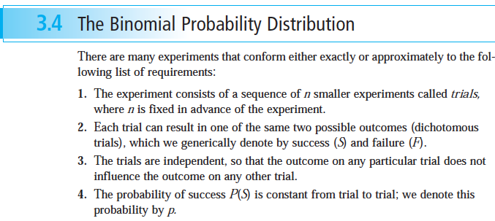
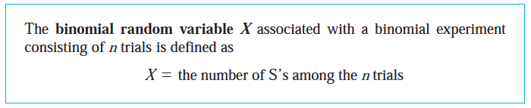
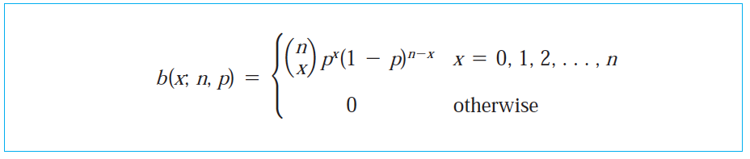
Binomial Distribution
From Devore textbook

Slide 35
Binomial
n
x
=
n!
x!(n-x)!
You can use tables or a computer program: in matlab Y=binopdf(x,n,p);
(where x is the number of successes in n trials, and p is the probability of a successful trial: 0.5 for a fair coin flip)
In python, https://docs.scipy.org/doc/scipy/reference/generated/scipy.stats.binom.html

Slide 36
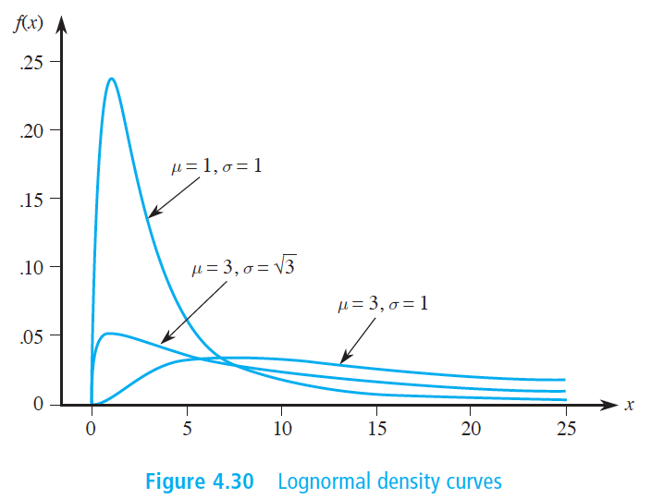
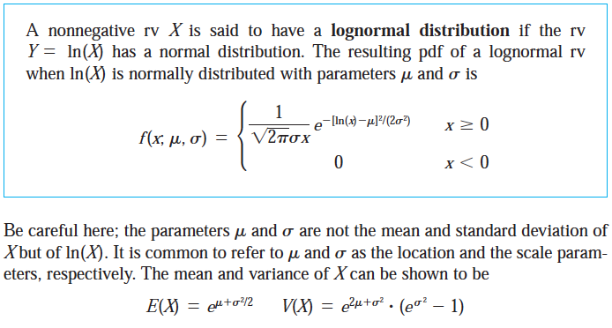
LogNormal Distribution
From Devore Ch 4

Slide 37
Estimating CDFs from Observed Data

Slide 38
CDFs from Observed Data:
An estimated CDF from observed data can be constructed as follows:
1) Rank the observed sample data from highest value to lowest value
2) Apply an unbiased quantile estimator to the ranked data
(Note that this gives probability of exceedance; 1 – quantile is typical CDF)
Simulated Annual Peak Flow (cfs)
Probability of Exceedance

Slide 39
Unbiased Quantile Estimator
Also called Quantile Mapping
(Cunnane formulation, see e.g. Handbook of Hydrology)
Q = (m – 0.4)/(N + 0.2)
Where Q = estimated quantile (probability of exceedance)
N = total number of observations
m = rank position ( where 1 = highest value)

Slide 40
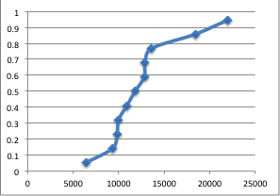
Cumulative probability
Annual peak discharge (cfs)
Cunnane Quantile Estimator Spreadsheet:
in the “tools” folder
cunnane_quantile_estimator.xls

Slide 41
Creating empirical PDFs
Take the derivative (or the difference) of the empirical CDF.
Should look similar to the histogram, except the area under the curve is 1.
Can create a histogram and then divide by the total number of samples multiplied by the bin width. (We did this in lab 1.)

Slide 42
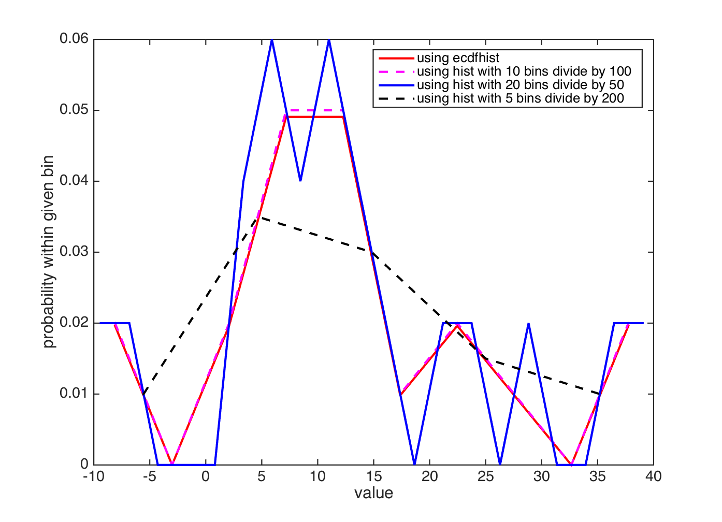
There are multiple ways to make an empirical PDF – CDF is the less ambiguous form.

Slide 43
Generating Random Numbers from a Given Probability Distribution

Slide 44
Generating a Sample of N Random Numbers from a Desired Probability Distribution:
The basic approach:
Generate N random numbers from a uniform distribution on the interval [0,1]. For homework, using the RAND function in Excel or Matlab or numpy’s np.random.uniform function is fine, but keep in mind that good number generators are hard to build. (See Numerical Recipes in C or Random Numbers in Matlab, for example, for a detailed discussion of this topic.)
Remember that a CDF always ranges from 0 to 1 for a set of numbers.
Map the quantile value from the randomly generated number (which is just the number extracted from the standard uniform distribution) to the quantile value from the desired probability distribution using the CDF of the desired distribution.
The approach can be applied to any distribution for which we have a CDF available as a closed form expression or a simple lookup table. Note that you will need to expand this distribution to 0 and to 1. Note that we can also generate random samples from an empirically derived CDF from data (as you will do in your homework 2).
Example random number generator spreadsheet for the normal distribution:
In “tools”: uniform_to_normal_random_number_generator.xlsx

Slide 45
Example:
Generate a random sample of normally distributed numbers with mean 2 and standard deviation 4 .
Percentile
mean | 2
standard | 4
uniformly distributed rand numbers | normally distributed numbers |  | z
0.255548012 | -0.8 |  | -0.7
0.81325883 | 5.4 |  | 0.85
0.202865518 | -1.6 |  | -0.9
0.703119481 | 4 |  | 0.5
z = -0.7
z
As noted above, a normally distributed number N can be expressed as N = μ + z*σ , where z is called the “standard normal variate” (i.e. the number of standard deviations from the mean). For the standard normal distribution (μ = 0, σ =1) the CDF maps the quantile position to z.
For the first number generated above, the quantile position in the uniform distribution is 0.255 (i.e. the 25.5th percentile), which corresponds to -0.7 standard deviations from the mean in the normal distribution (i.e. z = -0.7). Therefore the normally distributed equivalent number is:
N = 2 - 0.7*4 = -0.8

Slide 46
Random numbers with matlab
rand uniform distribution from 0 to 1
randn normal distribution with mean of 0 and variance 1
randi(imax) scalar integers only between 1 and imax
Potentially useful: http://www.mathworks.com/help/matlab/math/random-numbers-with-specific-mean-and-variance.html

Slide 47
Random numbers with python
Lab 1.2 walks you through how to use the numpy package to generate random numbers
You can also learn more about these functions on the scipy website, for example: https://docs.scipy.org/doc/numpy-1.14.0/reference/generated/numpy.random.normal.html

Slide 48
At this point, you have all needed information for HW 1 Notes: Put comments in your code. Quantile plots can be CDF (prob of <= a value) or exceedance plots (prob > a value) As long as you label clearly, either is okay for homework.

Slide 49
Confidence Intervals

Slide 50




300 cm
250 cm
200 cm
150 cm
100 cm
50 cm

Slide 51


Dec 3, 2014: ?? cm ± ?? cm
50 cm
45 cm
40 cm
35 cm
30 cm
25 cm
20 cm
15 cm
You wrote your best guess (both parts).
Notes:
Ryan said 20 cm, so clearly Ryan vs. Jessica is worse than Teddy vs Eric.

Slide 52
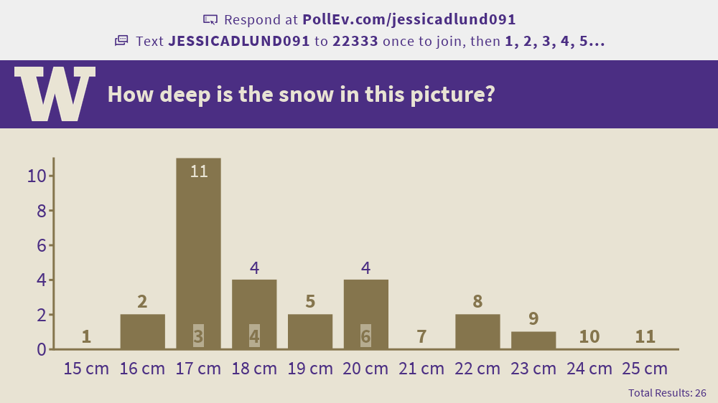
Sept 27, 2019 results

Slide 53
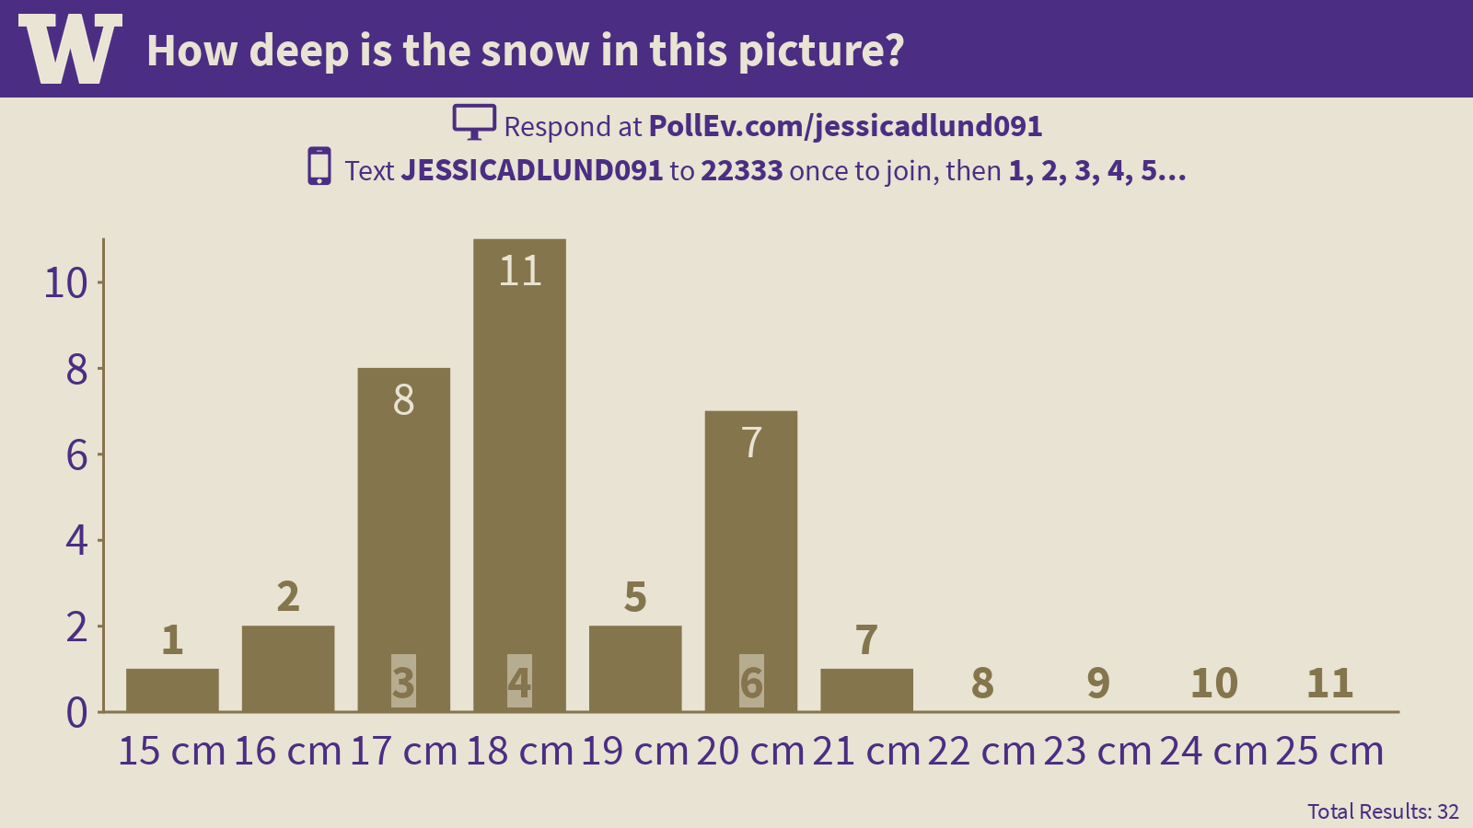
Results from Wednesday, September 26, 2018: Can we determine the certainty from the collection of best guesses?

Slide 54
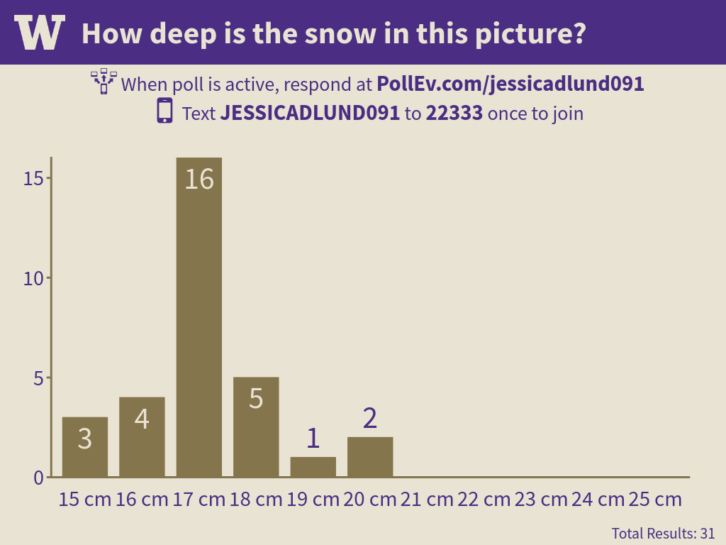
Results from Wednesday, September 27, 2017: Quite different: Any ideas why?

Slide 55
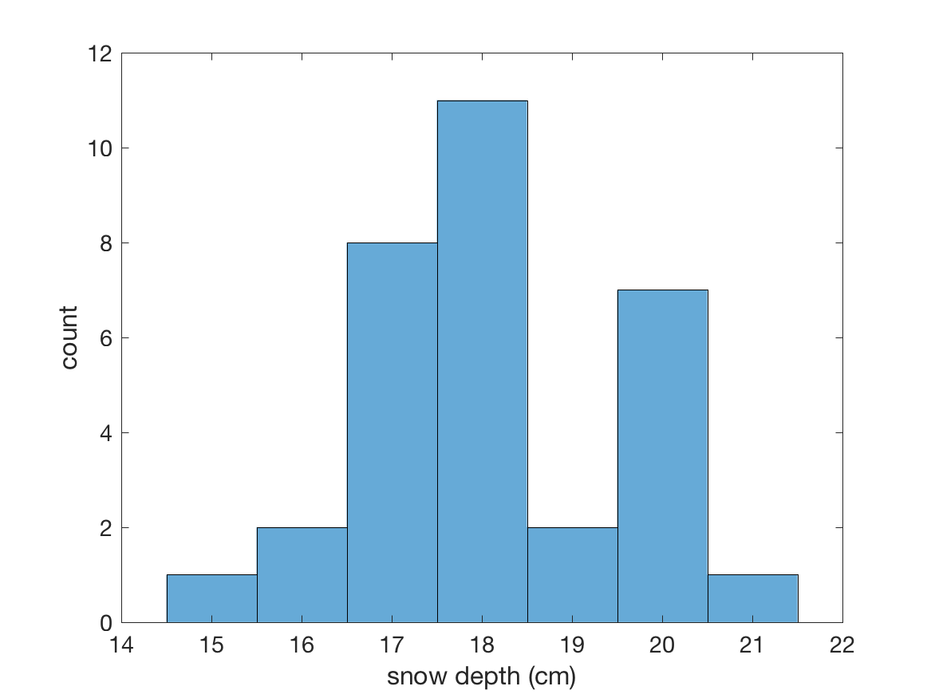
Confidence of “true value” from a distribution
How wide?
What certainty do we want?
95% confidence intervals?
90% confidence intervals?

Slide 56
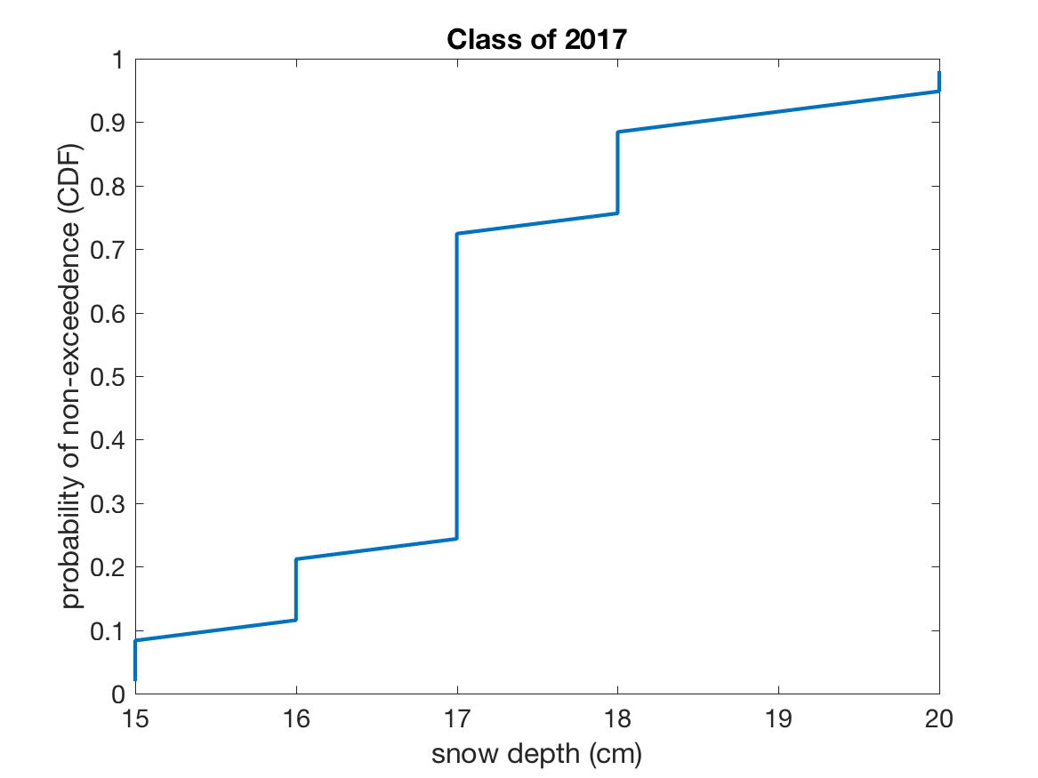
Apply Quantile Mapping (which we just learned)
Sort the answers in descending order
CDF_value = 1 – (rank - 0.4) /(num_samples + 0.2)
Plot snow depth vs. CDF_value, using the sorted snow depths

Slide 57
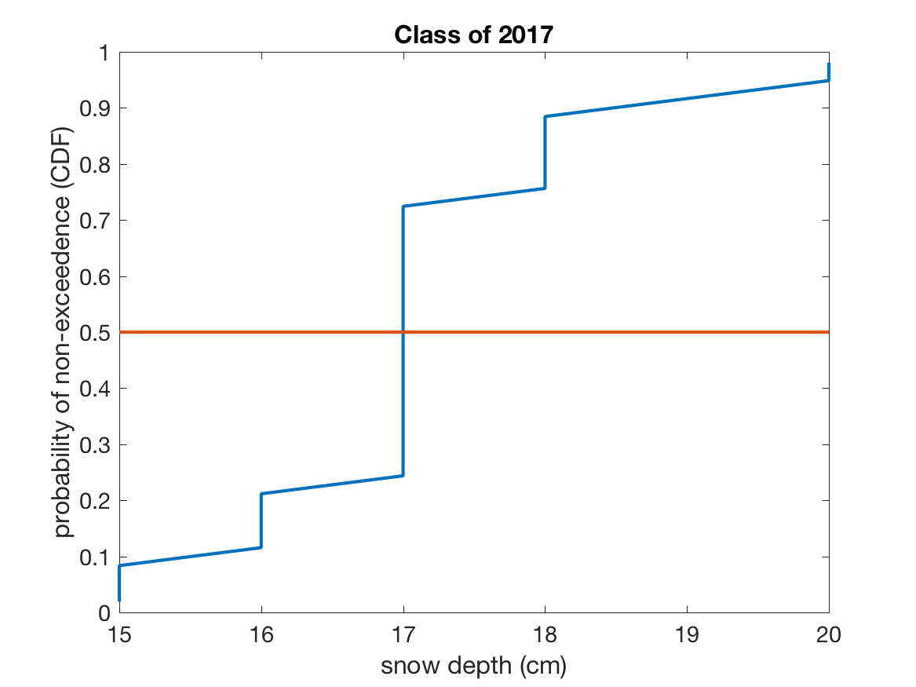
The CDF let’s us readily identify the median value:
Median = 17 cm

Slide 58
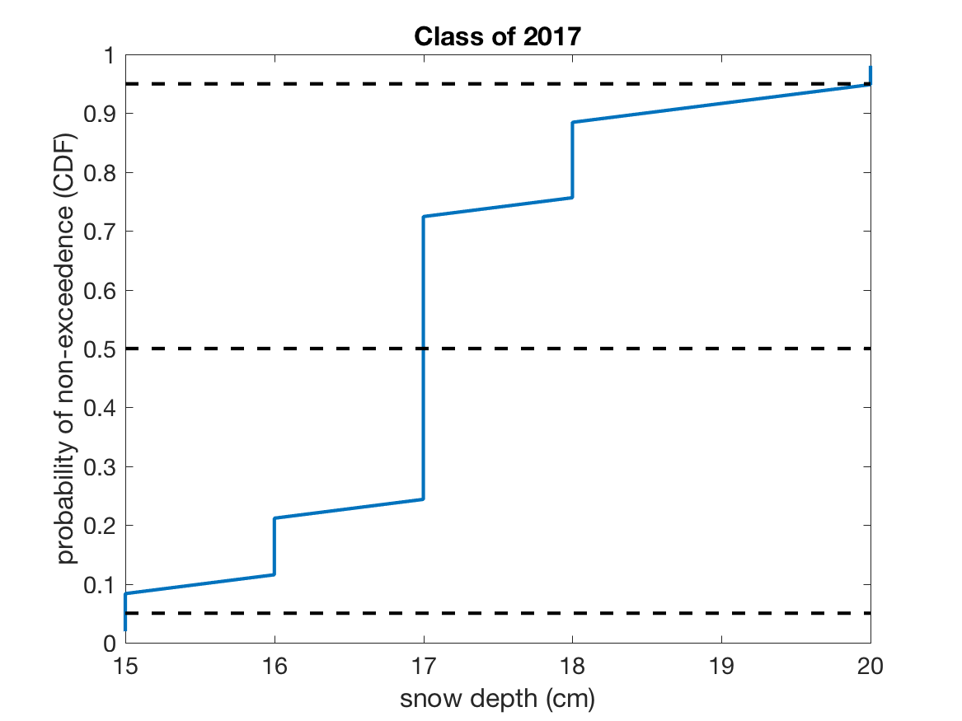
It also shows us confidence intervals:
What confidence interval is shown between these two dashed lines?

Slide 59
It also shows us confidence intervals:
What is the total probability of truth falling outside of these two dashed lines?

Slide 60
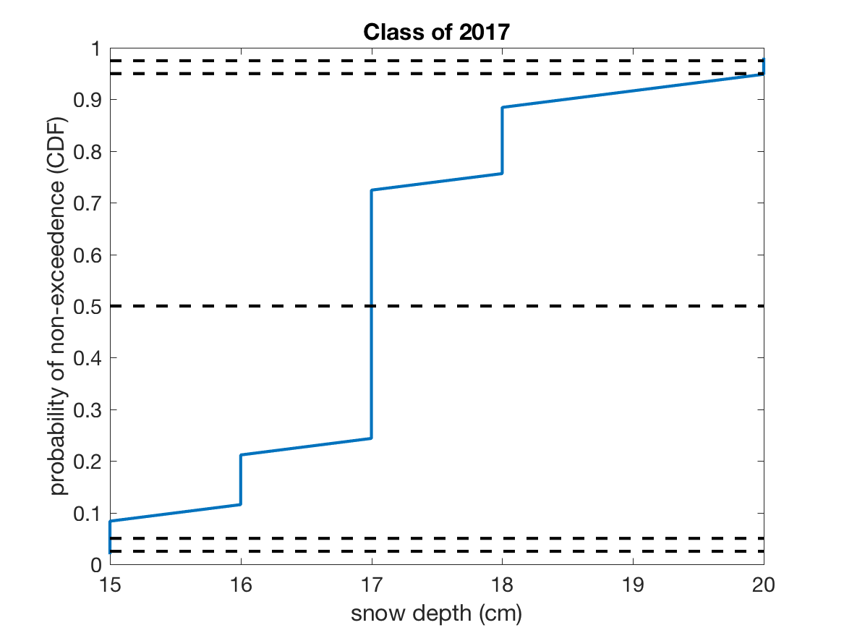
95% confidence is from 0.025 to 0.975.
95%
90%

Slide 61
What things should we notice about this graph?
95%
90%
15 to 20 cm (17 + 3 or -2 cm)

Slide 62
What things should we notice about this graph?
95%
90%
15 to 20 cm (17 + 3 or -2 cm)
1. Our confidence intervals are not symmetric.

Slide 63
What things should we notice about this graph?
95%
90%
15 to 20 cm (17 + 3 or -2 cm)
2. We would write the same confidence intervals for 90 or 95%.

Slide 64
What things should we notice about this graph?
95%
90%
15 to 20 cm (17 + 3 or -2 cm)
2. Our sample size does not resolve better than 90%.

Slide 65
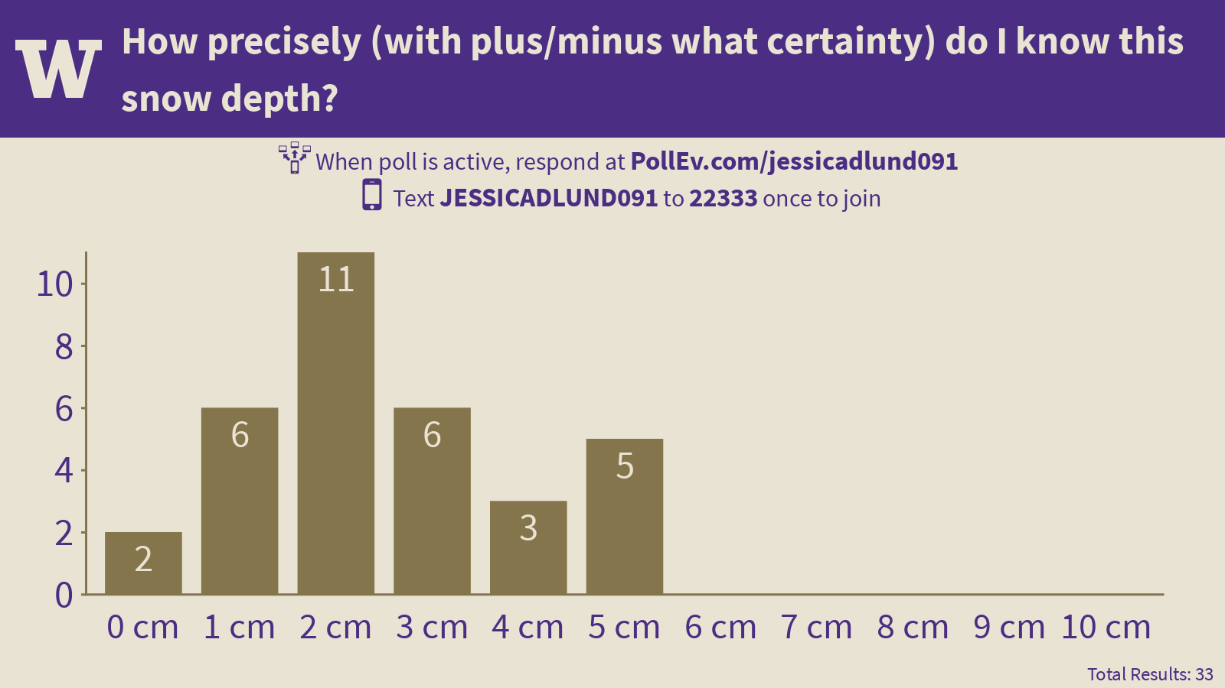
Do our collection of individual guesses on the certainty correspond to the confidence derived from our group’s collection of guesses for the true value?

Slide 66
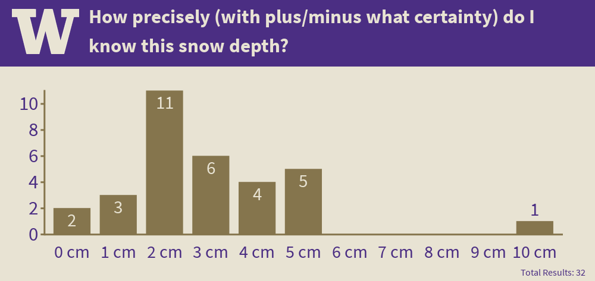
2019 Results: Most people said 2 cm, which agrees with the results from the distribution

Slide 67
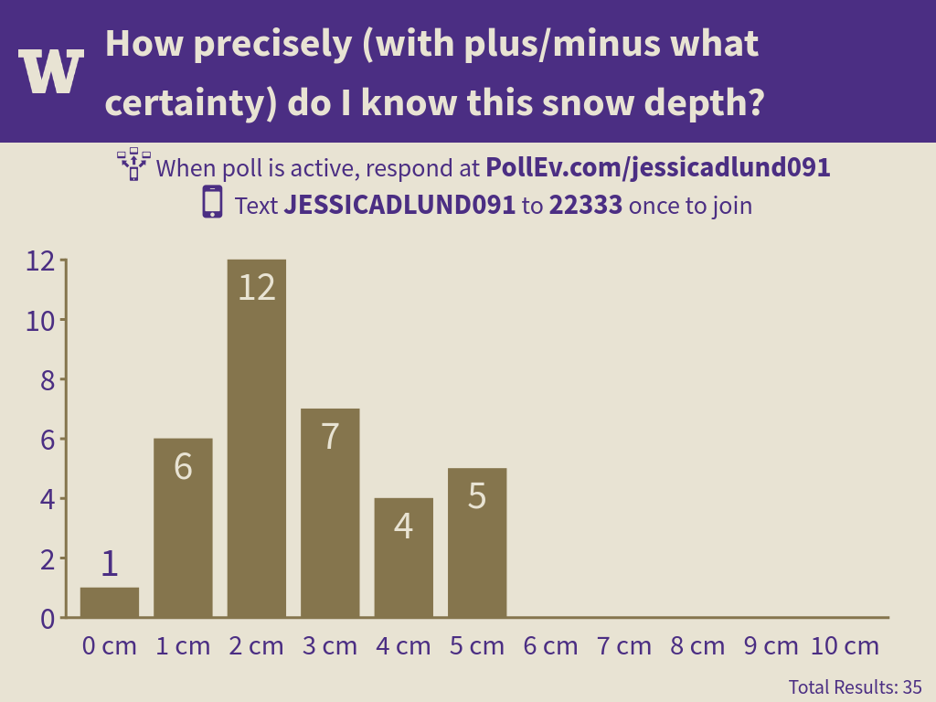
2017’s class estimates on uncertainty were actually closer to this years than the mean values!

Slide 68
Hypothesis Testing

Slide 69
Hypothesis Testing in the Context of Systems Analysis
In a systems engineering context, testing hypothesis about changing statistical parameters can be thought of as “detective work,” using observed data to determine if a system is likely to have changed.
For example, flooding in forested mountain watersheds in the Pacific Northwest has been hypothesized to be affected by logging (e.g. due to increases in snowpack and increased soil moisture).
One way of attempting to support this hypothesis is to examine data before and after a substantial portion of a particular basin was logged, and evaluate whether the changes seen in the data are statistically significant or not. (HJ Andrews Streamflow Project.)
In inference testing we typically establish a null hypothesis (a mathematical statement), a set of alternative hypotheses, and a quantitative test procedure for rejecting the null hypothesis in favor of one of the alternative hypotheses:
We either:
reject the null hypothesis in favor of one of the alternative hypotheses, or
do not reject the null hypothesis.

Slide 70
In 2017, I asked students to make two guesses of snow depth. I hypothesized that the class’s second guess of snow depth increased relative to the first guess. [Note: I came up with this hypothesis before looking at the data.] Null Hypothesis: ???

Slide 71
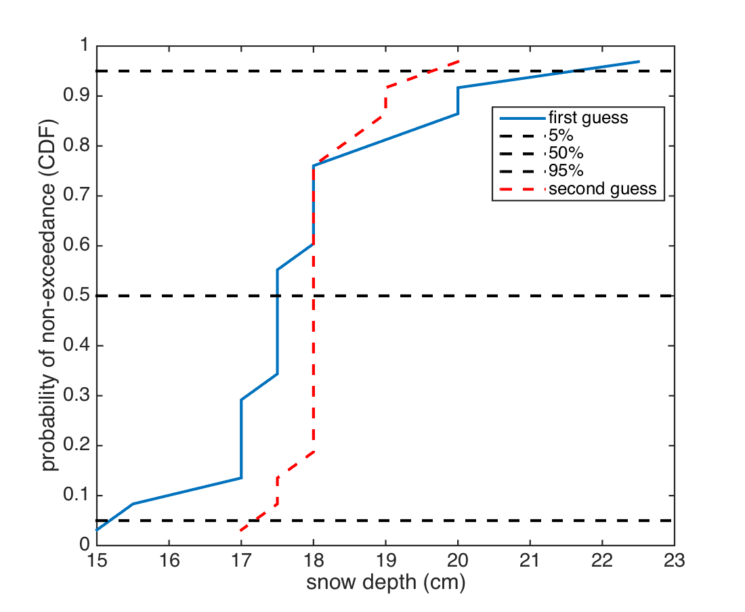
Median increased 17.5 to 18 cm Is that significant?

Slide 72
Type I and Type II Errors
At least two potential kinds of errors exist:
Type I Error: We reject the null hypothesis when in fact it is true.
In most hypothesis testing the Type I error is selected prior to conducting the tests. The probability of a Type I error is usually represented by the symbol α. The Confidence of the test is (1 – α). E.g. if the Type I error is 0.05 then the confidence is 0.95.

Slide 73
Type I and Type II Errors
At least two potential kinds of errors exist:
Type II Error: We do not reject the null hypothesis when in fact it is false.
Type II error is usually represented by the symbol β, and the quantity (1 – β) is called the Power. The Power is the likelihood that we would successfully avoid a type II error for a given assumption of the true nature of probability distribution. I.e. the Power is the likelihood that we would correctly conclude that a change in the probability distribution had taken place, if in fact a change of a certain assumed magnitude had occurred.
The Type II error is a function of α and the posited true nature of the probability distribution we are hoping to detect (i.e. we decide how different the true probability distribution is from the null hypothesis, and then see how likely we would be to make a mistake ).

Slide 74
 | We reject the Null Hypothesis | We do not reject the Null Hypothesis
Null Hypothesis is True | Type 1 Error | Success!
Null Hypothesis is False | Success! | Type 2 Error

Slide 75
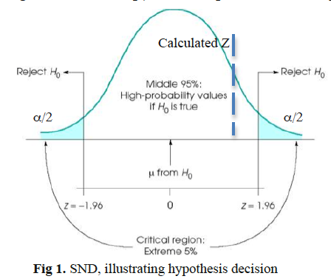
If H₀ is the true mean, there’s only a 5% chance that the value legitimately fell in the tails of the distribution. So, if you reject the null hypothesis, there’s only a 5% chance that you were unfairly doing this, and thus you have 95% confidence that you’re correct to reject it. That’s Type I error.
In case shown here, we don’t reject the null. What if we should have rejected the null hypothesis? That’s Type II error (more on that later, but note that ATMS552 pdf 1 in 20 chance on type II error is a typo, first mention should be type I error).
From Hypothesis testing Summary.pdf (notes from Advanced Hydrology Class)

Slide 76
Inferences Regarding Changes in the Mean

Slide 77
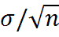
Inferences Regarding Changes in the Mean
In these problems, we typically have at our disposal a sample data set with:
a sample size of n
a sample mean
and a sample standard deviation (i.e. the variance is )
Restatement of the Central Limit Theorem (see http://en.wikipedia.org/wiki/Central_limit_theorem):
If a sample of n values is extracted at random from a population with mean μ and standard deviation σ, and n > 30, then the means of these samples are approximately normally distributed and have a standard deviation of:
Thus we can test whether our sample with mean is likely to have come from a hypothesized population with a “true” mean μ and standard deviation σ. (Value in this is that means are normally distributed even when original distribution is not!)

Slide 78
CDF = Cumulative Distribution Function
Percentile
z = 1.65
This is z for an alpha of 0.05.
z
A normally distributed number can be expressed as x = μ + z*σ , where z is called the “standard normal variate” (i.e. the number of standard deviations from the mean).

Slide 79
Large Sample Tests

Slide 80
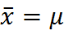
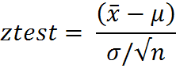
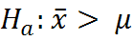
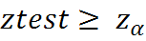
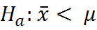
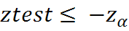
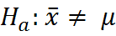
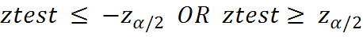
Single Sample Test:
Null Hypothesis:
Let α = Probability of a Type I error.
Test statistic: (i.e. number of standard deviations from the mean)
Alternate Hypothesis: Rejection Region:
one-sided
one-sided
two-sided

Slide 81
Should it be 1-sided or 2-sided?
See page 104-106 of Helsel and Hirsch.pdf

Slide 82
What should alpha be?

Slide 83
Significance Level
The significance level associated with a given set of sample statistics (often denoted P) can also be calculated.
Definition:
For a given set of sample statistics, P is defined as the lowest value of α for which the null hypothesis would be rejected.
*Note that if P is smaller than α, then the null hypothesis would be rejected.
(Although see notes from Professor Hartmann saying that you must always state the significance value before you calculate P statistic or he will call you a “mush-headed scoundrel.”
Also, recent set of articles on the p-value from the American Statistical Association – will discuss later.)

Slide 84
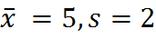
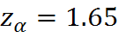
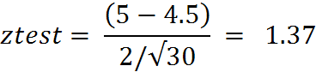
Example:
Suppose from a sample data set of size n = 30 we calculate:
Is this sample mean statistically different from 4.5 for α = 0.05 if s=2 ?
So we cannot reject the null hypothesis.
By looking up 1.37 in the standard normal distribution CDF we find P, the value of α for which the null hypothesis would be rejected. In this case P = 1 - 0.915 = .085

Slide 85
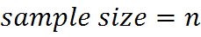
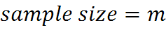
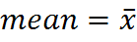
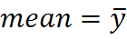
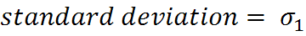







Two Sample Test:
Sample 1: Sample 2:
Then provided n and m are both larger than about 30,
is normally distributed.
The null hypothesis:
Alternate hypotheses: etc.

